Slide 1

COM3123 - Lecture 6
Express & MongoDb

Slide 2
Topics
MongoDb
Mongoose CRUD Operations
Express
Router
Application Structure
Code Review
Node Lab Test

Slide 3
Mongoose Model CRUD

Slide 4

Mongoose READ Methods
find() - method to retrieve all records from Particular collection
findById() - used to fetch record from schema based on your mongo Id
findOne() - used to get 1 record from schema based on condition

Slide 5
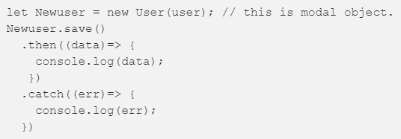
Mongoose CREATE Methods
save() - is used to insert a record in collection. It is used with Model object. ie. we have to create a model object
insert(), insertMany() or create() - are used to insert arrays of records into collection
insertOne() - insert single record in collection, like save() but faster

Slide 6

Mongoose UPDATE Methods
update() - used to update a record based on condition
findOneAndUpdate() - combination of read and update a record in collection
findByIdAndUpdate() - used to update a record based on Id

Slide 7

Mongoose DELETE Methods
delete() - is used to delete a document based on a condition
deleteMany() - used to remove all documents matching given filter

Slide 8
Express Router & Generator

Slide 9
Express Router
Use the express.Router class to create modular, mountable route handlers.
A Router instance is a complete middleware and routing system; for this reason, it is often referred to as a “mini-app”.
Create a router as a module, loads a middleware function in it, defines some routes, and mounts the router module on a path in the main app.

Slide 10
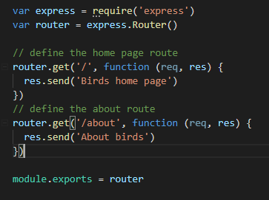
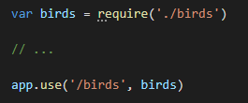
express.Router
Load the module in the main app.js, the app will now be able to handle /birds and /birds/about

Slide 11

Express application generator
Use the application generator tool, express-generator, to quickly create an application skeleton.
The express-generator package installs the express command-line tool. Use the following command to do so

